Slide 1

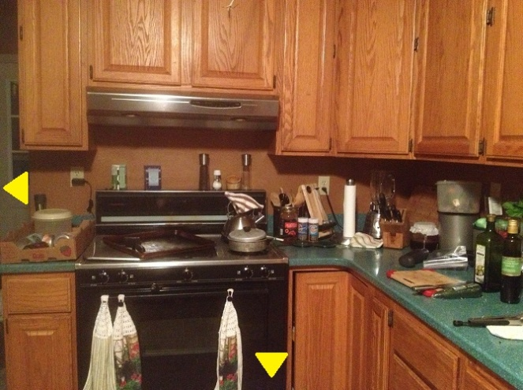
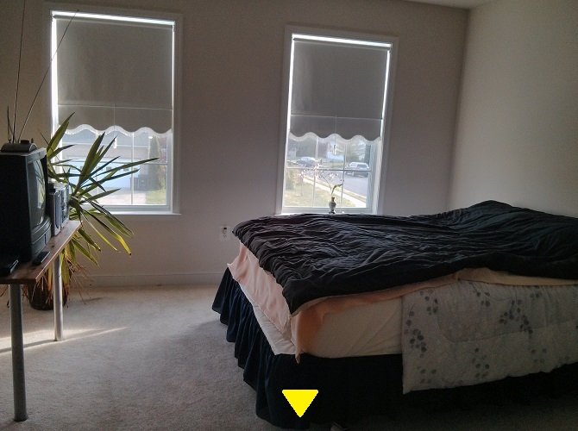
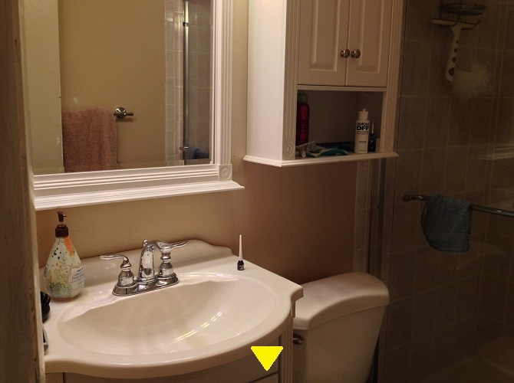
Scavenger Hunt
By the Pickpockets
Notes:
Kelsey introduce game

Slide 2

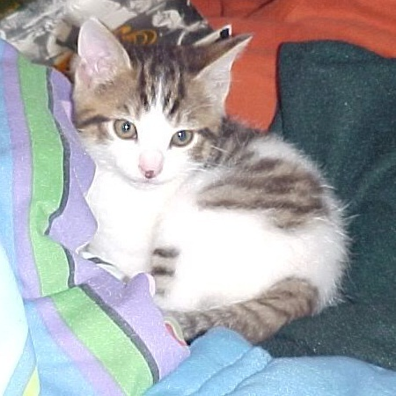
Kelsey Gardner
Project Manager; Asset Designer
• Came up and coded original prototype
• Photographer and main asset designer
• Contributed game and story details
• Set up GitHub and Blogspot
Notes:
Kelsey Introduction

Slide 3

Mohammad Salim
Assistant Programmer; Video Editor
• Modularized code
• Created Pause Menu
• Video editor
• Contributed game and story details
Notes:
Mohammad Introduction

Slide 4

Victor Callejas
Assistant Programmer
• Programmed beta version of subtitles and generated transition arrows
• Contributed game and story details
• Assisted with level transitioning layout
Notes:
Victor Introduction

Slide 5
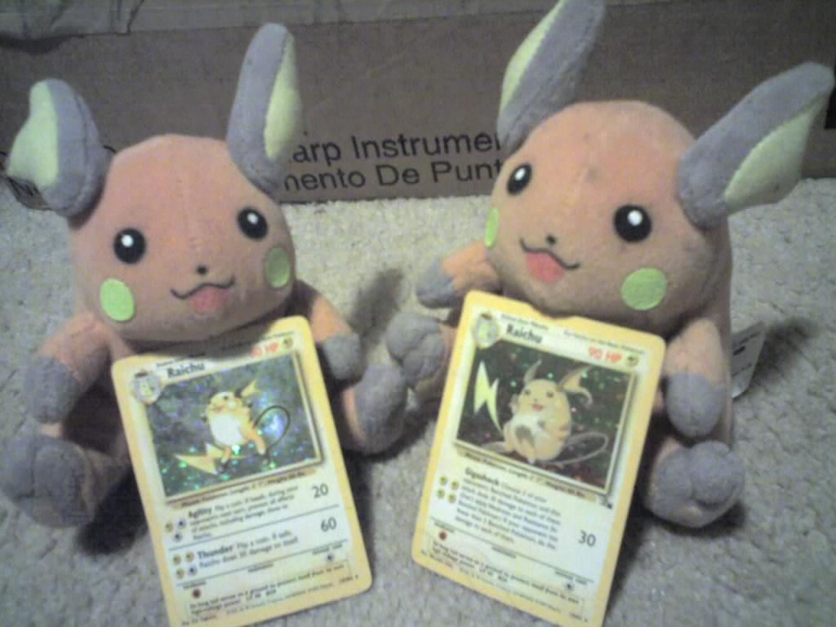
Tom Tran
Lead Programmer; Story Planner
• Created baseline story
• Programmed levels, puzzles, cutscenes, and main menu
• Contributed game and story ideas
• Supplied main setting of game
Notes:
Tom Introduction

Slide 6

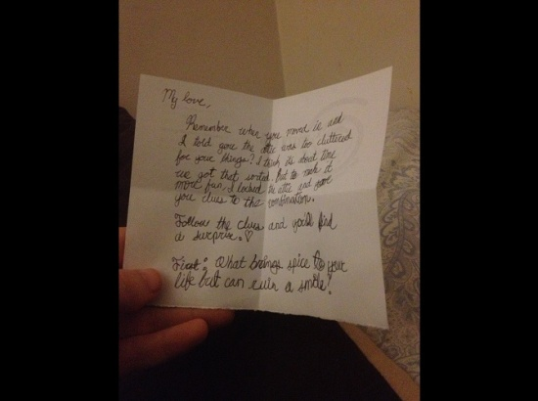
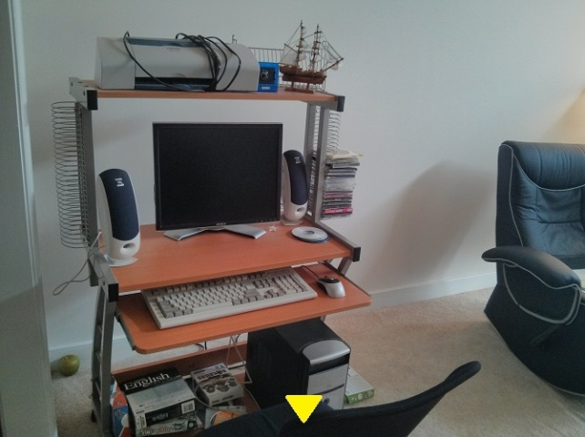
Game Overview
Psychological point and click
Features
Interactive objects
Locked areas and puzzles
Cutscenes
Videos
Pause menu to hear current note
Gather clues to progress through the story and learn more about Caroline and Michelle.
Notes:
Kelsey talk about gameplay and story

Slide 7
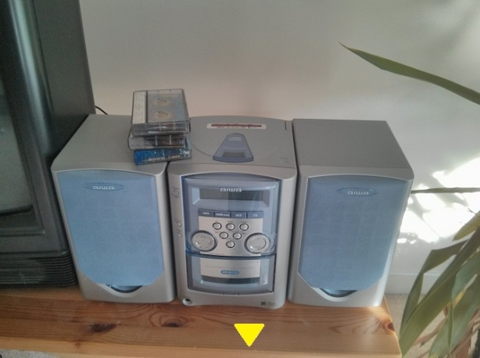
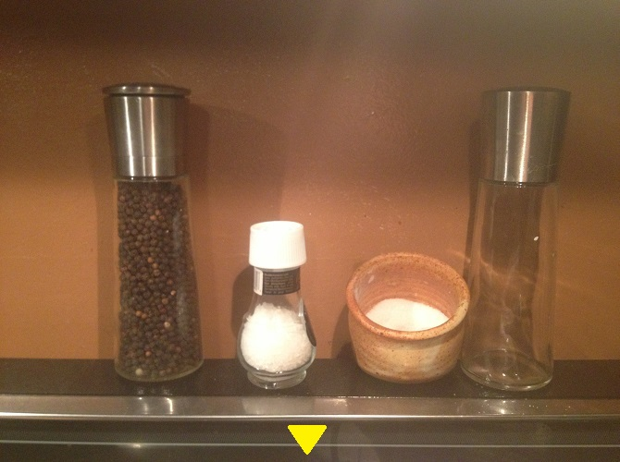
Improvements
Changes since Prototype
Improvements
Modularized code
Main menu
Pause menu
Csv level loading
Videos
Full story
-More rooms, puzzles, and cutscenes
Audio bugs
Skippable cutscenes
Much of the original prototype code and content were retained
Notes:
Tom talk about improvements over prototype

Slide 8
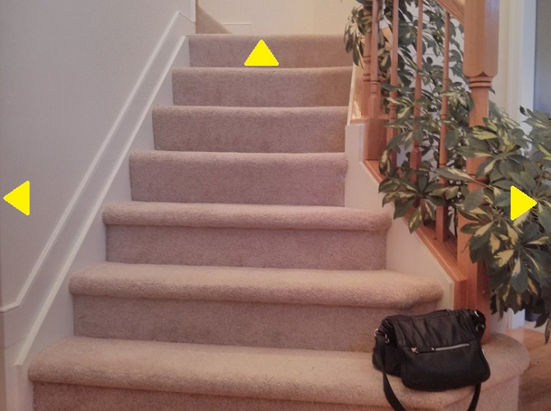
Obstacles
• Cell phone with our photo resources was stolen halfway through the project
• Difficult to coordinate with different schedules
Notes:
Victor talks about obstacles

Slide 9
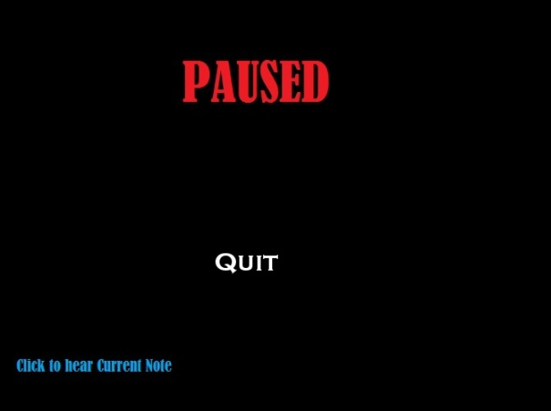

Things to Improve
Features Needed
Polish polish polish!
Game title
Save\Load
Options
Volume
Screen resolution
Subtitles
Notes:
Mohammad talks about things we can improve on

Slide 10
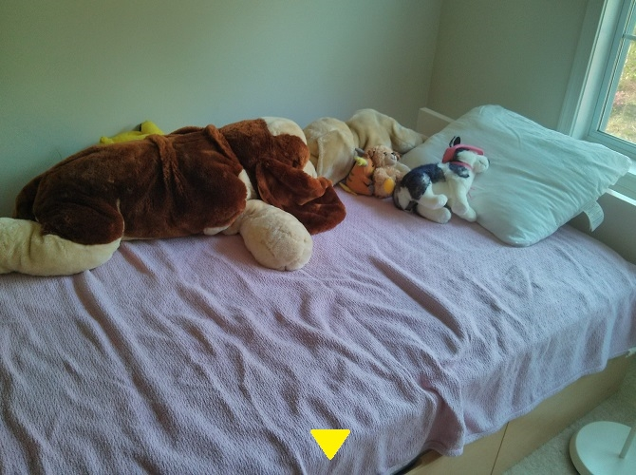
Questions??

